Slide 1
EDA of Movie Data
There is list of 1000 Movies between 2006 to 2016.

Slide 2
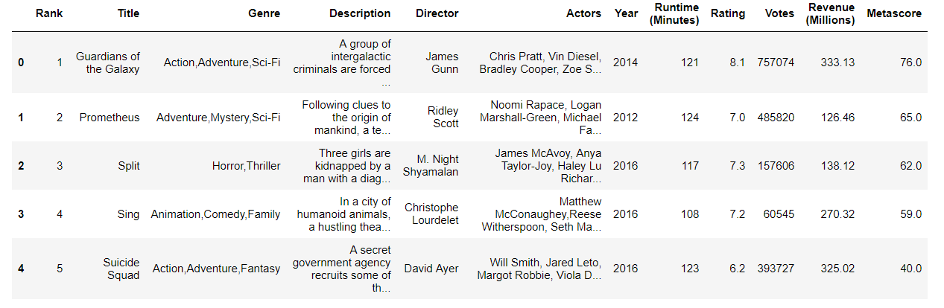
Sample Data

Slide 3
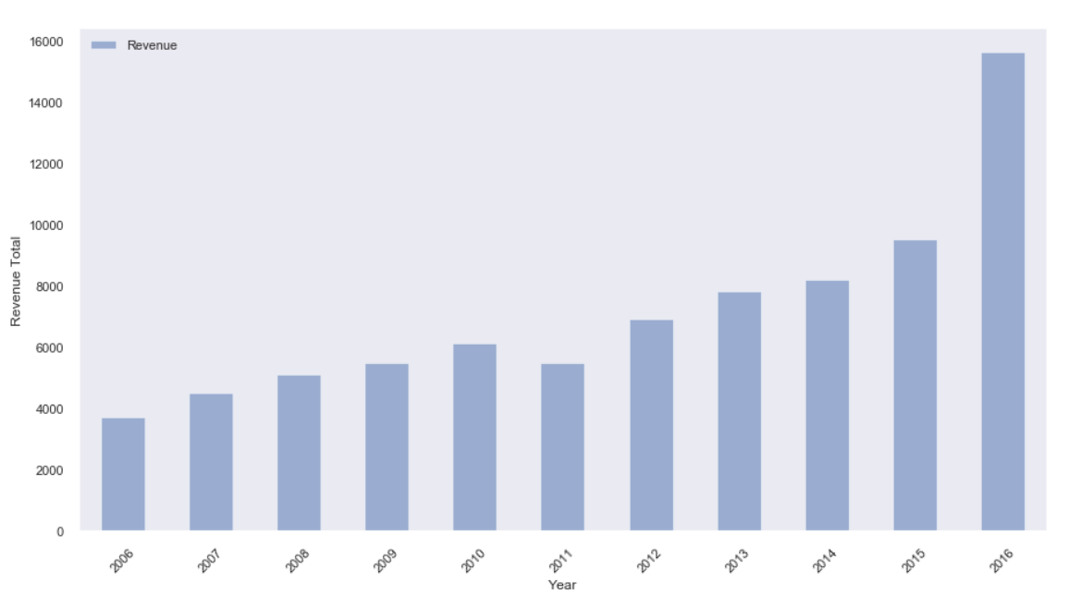
Yearly Revenue
Year 2016, has maximum Revenue

Slide 4
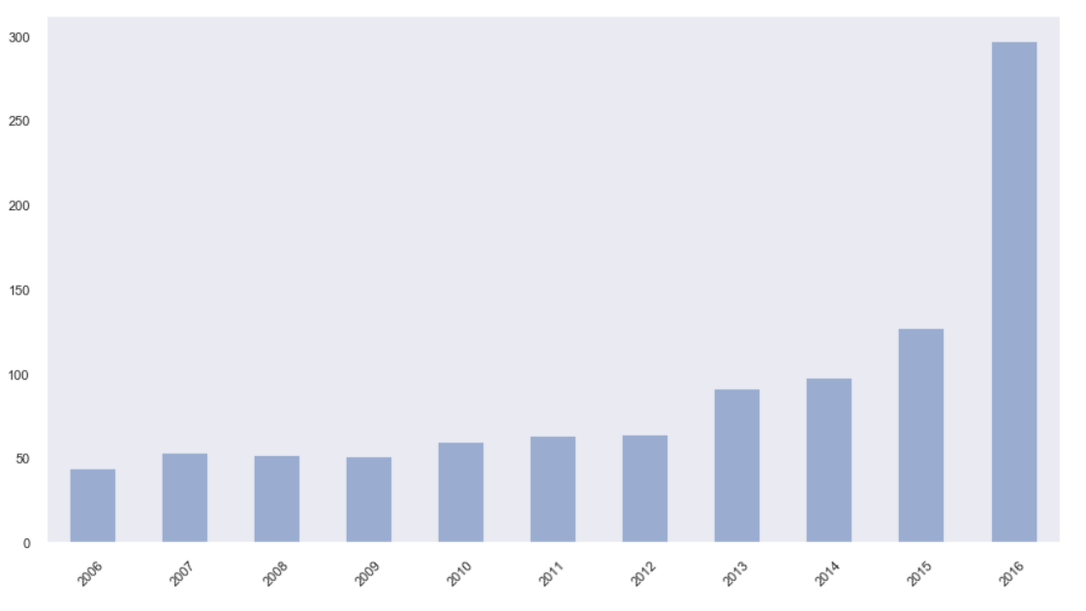
Yearly Movie Released
Year 2016, has maximum Movies released.

Slide 5
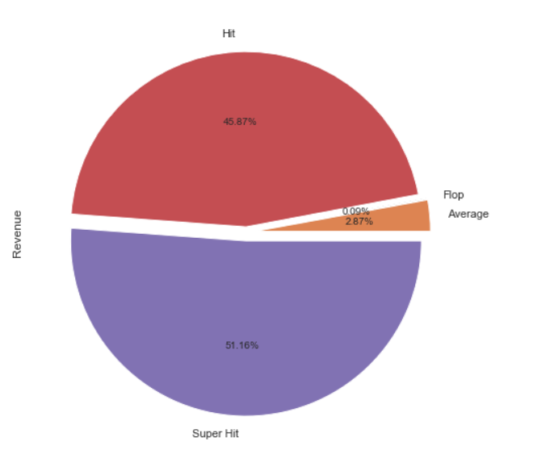
Correlation between Hit / Flop and Revenue
As per Viewers rating, Super Hit movies has Maximum Revenue Percent (51.16%)

Slide 6
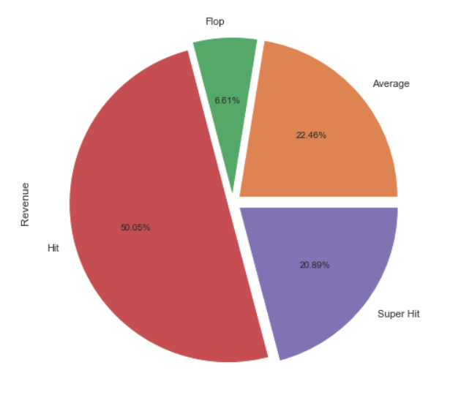
Correlation between Critic Review and Revenue
As per Critic rating, Hit movies has Maximum Revenue Percent (51.16%)

Slide 7
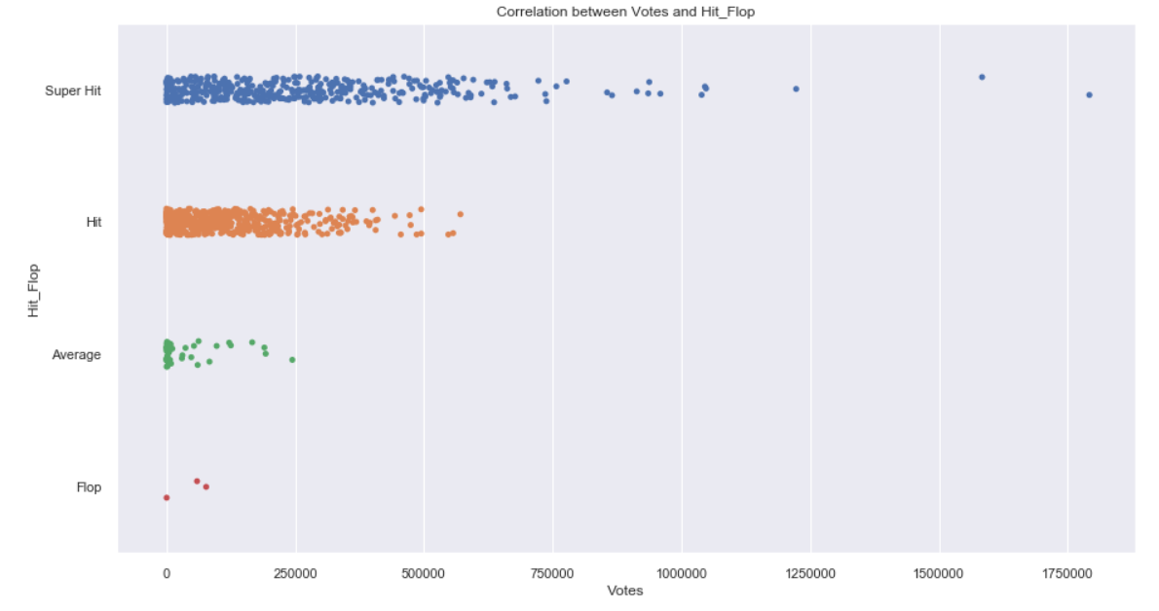
Correlation between Hit / Flop and People Votes
As per Viewers Votes, Super Hit movies has gradually increased after 300000. There are some outliers.

Slide 8
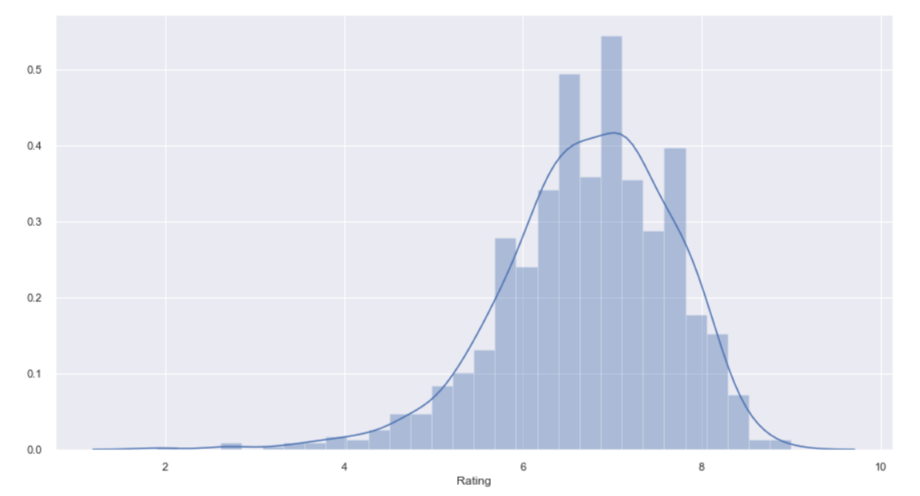
Rating Spread
Rating Spread is maximum concentrated between 6 and 8.

Slide 9
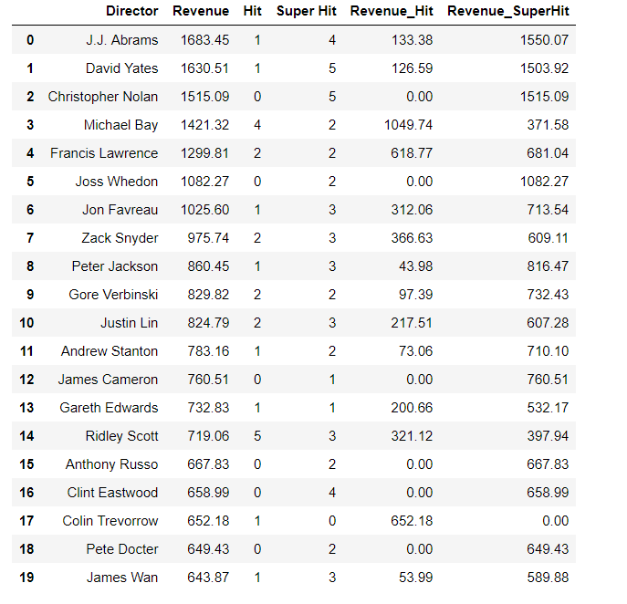
Top 20 Director Revenue, Hit / Flop

Slide 10
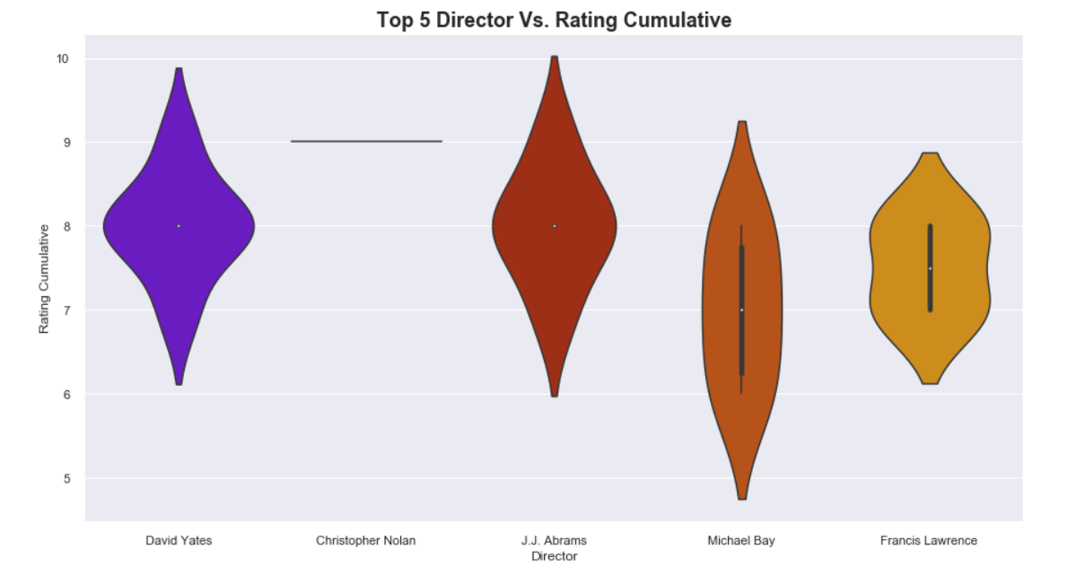
Top 5 Director Movie Ratings
Top 5 Director has rating concentrated more towards 7 to 8. “Michael Bay” has some movie below Rating 5. “Christopher Nolan” all movies are around 9.

Slide 11
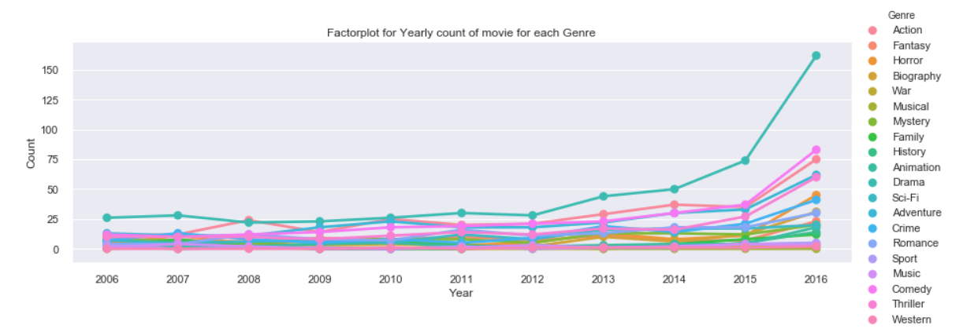
Yearly Genre based movie released
Year 2016 has most released movies of type “Sci-Fi” Genre.

Slide 12
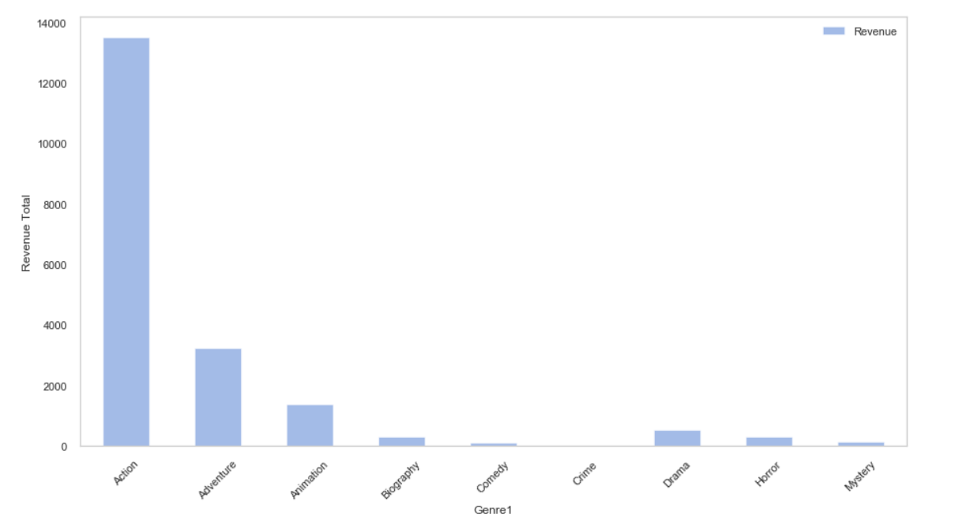
Top Genre wise Revenue
“Action” Genre movies have maximum Revenue which is above 12000 millions

